Slide 1
What is a computer?

Slide 2
CS250 Computer Architecture
George B. Adams III
Purdue University
Spring 2018

Slide 3
EMERGENCY PREPAREDNESS (part 1)
To report an emergency, call 911. To obtain updates regarding an ongoing emergency, sign up for Purdue Alert text messages, view www.purdue.edu/ea.
There are nearly 300 Emergency Telephones outdoors across campus and in parking garages that connect directly to the PUPD. If you feel threatened or need help, push the button and you will be connected immediately.
Notes:
One final piece of Purdue business before we begin: as we start this semester I want to take a few minutes to discuss emergency preparedness. Purdue University is a very safe campus and there is a low probability that a serious incident will occur here. However, just as we receive a safety briefing each time we get on an aircraft, we want to emphasize our emergency procedures for evacuation and shelter in place incidents. Our preparedness will be critical if an unexpected event occurs.
Purdue prepares for natural disasters or human‑caused incidents with the ultimate goal of maintaining a safe and secure campus, but in the end, emergency preparedness is your personal responsibility. Let’s quickly review the following procedures:

Slide 4
EMERGENCY PREPAREDNESS (part 2)
Fire (loud buzzing alarm and flashing lights)
Exit to the outdoors
Walk on the right
Do not use an elevator
Meet up at REC (Recitation) by the northeast door
Notes:
One final piece of Purdue business before we begin: as we start this semester I want to take a few minutes to discuss emergency preparedness. Purdue University is a very safe campus and there is a low probability that a serious incident will occur here. However, just as we receive a safety briefing each time we get on an aircraft, we want to emphasize our emergency procedures for evacuation and shelter in place incidents. Our preparedness will be critical if an unexpected event occurs.
Purdue prepares for natural disasters or human‑caused incidents with the ultimate goal of maintaining a safe and secure campus, but in the end, emergency preparedness is your personal responsibility. Let’s quickly review the following procedures:

Slide 5
EMERGENCY PREPAREDNESS (part 3)
If we are notified during class of a Shelter in Place requirement for a tornado warning, we will suspend class and shelter downstairs if there is time and in this room.
If we are notified during class of a Shelter in Place requirement for a hazardous materials release, or a civil disturbance, including a use of weapons, we will suspend class and shelter in the classroom, shutting the door and turning off the lights.
Please review the Emergency Preparedness website for additional information. http://www.purdue.edu/ehps/emergency_preparedness/index.html
Notes:
One final piece of Purdue business before we begin: as we start this semester I want to take a few minutes to discuss emergency preparedness. Purdue University is a very safe campus and there is a low probability that a serious incident will occur here. However, just as we receive a safety briefing each time we get on an aircraft, we want to emphasize our emergency procedures for evacuation and shelter in place incidents. Our preparedness will be critical if an unexpected event occurs.
Purdue prepares for natural disasters or human‑caused incidents with the ultimate goal of maintaining a safe and secure campus, but in the end, emergency preparedness is your personal responsibility. Let’s quickly review the following procedures:

Slide 6
CS250 – General Information
Prof. Adams
My office: HAAS 122
Email: gba@purdue.edu
GTAs
Labs and office hours in LWSN B160
Blackboard hosts syllabus, assignments, solutions, grades, announcements, lecture slides, supplemental material; course policies details
Piazza.com hosts online discussion

Slide 7
Grading
Semester grade weighting
Clicker quizzes 5%
Homework 15%
Lab assignments 40%
Midterm exams (2) 20% (10% each)
Final exam 20%
Grade computation will exclude
lowest lab score,
lowest homework score,
and lowest four (4) clicker scores
Notes:
DECIDE ON PERCENTAGES

Slide 8
Absences
Excused absence and the opportunity to make up missed classwork is available with written third-party documentation
Doctor
Dean of Students
Exclusion of lowest lab, homework, and (4) clicker scores is designed to support your routine needs to be absent or to load-balance CS250 with your other class assignments

Slide 9
Lecture
Attendance strongly recommended
Lectures include iClicker for-credit quizzes
Handwritten note taking recommended
Research shows that handwritten note taking results in better, faster learning
Better for making and annotating diagrams, which are key to describing computer architecture
Notes:
Research shows that handwritten note taking results in better, faster learning

Slide 10
Textbook
Essentials of Computer Architecture – Second Edition (2016), by Douglas Comer ISBN-13: 978-1138626591
We will cover circa 90% of its content
Copies on reserve at MATH Library front desk
Reading – key concepts, terminology, examples
Figures and exercises – starting points for exploring computer architecture designs

Slide 11
Homework and Lab Assignments
Objective is to
Gain experience with applying basic concepts
Develop deductive skills, insights, and intuition
Explore design alternatives
Self-test fluency and facility with course material
Assignments posted on Blackboard
Unlimited uploads of your answers document
Your final, timely upload is the one that will be scored
Notes:
Assignments are an excellent component of your exam preparation process.

Slide 12
Lab
Lab attendance is required
Lab projects
Assigned weekly
Provide hands-on experience with digital logic circuits and assembly language programming

Slide 13
Exams
Midterm #1 – Tuesday, Feb. 06, 6:30pm
Midterm #2 – Tuesday, Mar. 27, 6:30pm
Final Exam – may be as late as May 05
Notes:
Don’t leave for home without it (the final exam)!

Slide 14
Course “equipment”
Software
MicroSD card and USB flash drive
Hardware
Lab kit
Textbook
iClicker (use in lecture)
Paper and writing implement (use in lecture)

Slide 15
Course Resources
Blackboard – assignments, announcements, grades, course information details
Lecture – concepts and examples
Q&A – in lecture; Piazza (collaborative); Adams office hours; TAs in lab
Self-study
Textbook, .PPT – concepts, topics, definitions
Homework – develop and check understanding
Lab kit – design and hands-on experience
LWSN B160 all hours, except 6-7pm Mondays

Slide 16
About George Adams
Personal history
BS (VA Tech), MS and PhD (Purdue) in EE
focused on high-performance parallel computing
worked at NASA Ames Research Center and taught at Stanford University part time
Purdue work also in ECE, Birck Nanotechnology Center, Krannert
Current academic activity
CS 250, subject matter reading and writing
Enjoys
Science fiction
Collecting computer hardware and paraprosdokians

Slide 17
What to expect of your instructors
The TAs and I welcome you to CS 250
My task, our task, is to support you in your effort to succeed in this course
We welcome your questions: in class, in lab, in office hours, on Piazza, via email
We ask for your feedback throughout the semester
Notes:
Each of you belong here; the TAs and I are happy you are here.
This will be a demanding and reasonable course. I know that each of you can succeed in this course.
Be in touch with us throughout the semester.
What is working, what has failed, what could be better.

Slide 18
What I expect of students
Engage with the class
Integrity and honesty
Notes:
This will be a demanding and yet reasonable course. Do your work with integrity and honesty.
I will not take attendance in lecture, but not attending tends to undermine my support for your success.
That said, I understand the necessity of occasional absence. Let me know; I’m happy to arrange support for arranged absences.

Slide 19
Today’s assignment
Login to Blackboard to register your iClicker and register with Piazza
Attend your lab session this week and complete Lab 01
Read textbook Chapters 1 and 2
Notes:
UPDATE URL

Slide 20
Lecture 01 – What is a computer?
Power on; boot to multiuser
2018.01.08
All photos by George B. Adams III unless otherwise credited.

Slide 21
Civilization advances by extending the number
of important operations which we can perform
without thinking about them.
Alfred North Whitehead
An Introduction to Mathematics (1911)
I think it’s fair to say that personal computers have become the most empowering tool we’ve ever created.
Bill Gates
February 24, 2004
Notes:
Where are we today? How did we get where we are today?

Slide 22
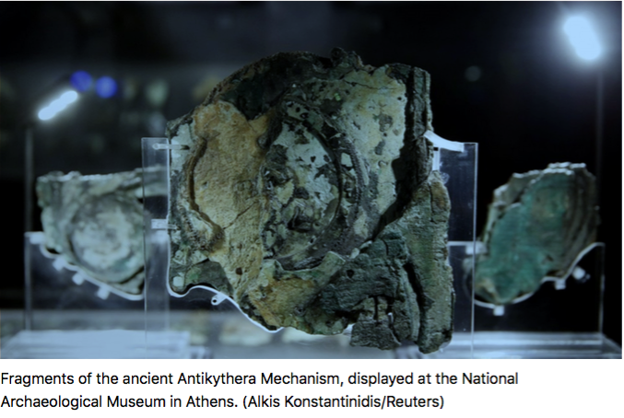
Antikythera Mechanism – computer, ca 200 BC
At least 30 bronze gears. Counted days for at least three different calendars and the timing of the Olympics. Pointers representing stars and planets revolved around its front face, indicating their position in relation to Earth. A black and white painted model of the moon rotated to model the real moon's waxing and waning.
Notes:
Fixed program and data.

Slide 23
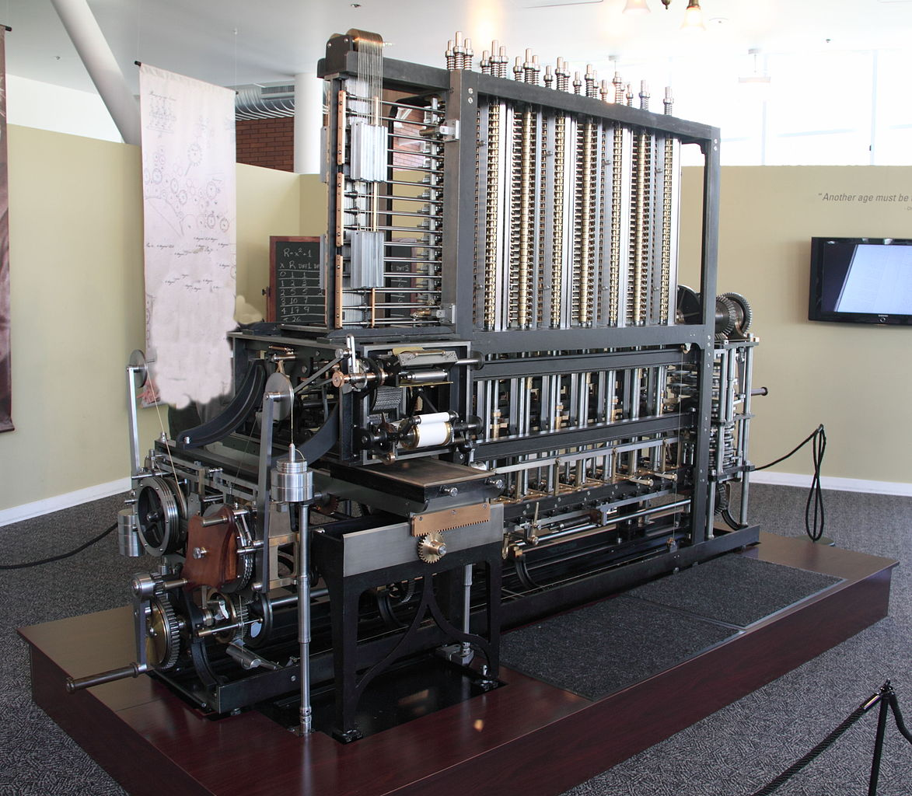
Charles Babbage – Difference Engine No. 2
Mechanical computer;
design completed 1849, 20 years before founding of Purdue University
Built in 2002
• 8000 parts
• 3.5 m long
• 10,000 kg
• hand crank powered
Solves 7th order polynomials to 31 decimal digits using the Method of Differences
Includes formatted printer for error-free output
Photo © Canticle at English Wikipedia
https://commons.wikimedia.org/wiki/File:Difference_engine.JPG
Notes:
WHAT DID MYRHVOLD PAY?
Was on display at the Computer History Museum until Jan. 31, 2016, now on display at Intellectual Ventures in Seattle, WA.
Fixed program and variable data.

Slide 24
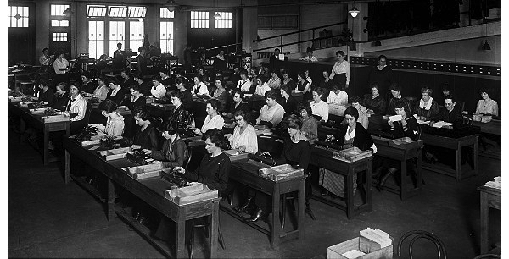
A widely employed computer until late 1940s
A team of Computers (a job title) working on a large calculation.
Common until the late 1940s. Image ca. 1920, US Library of Congress.
Hardware = desktop mechanical adding machines, furniture, and employees
Software = ?
A team of Computers (a job title) working on a large calculation.
Common until the late 1940s. Image ca. 1920, US Library of Congress.
Hardware = ?
Software = ?
A team of Computers (a job title) working on a large calculation.
Common until the late 1940s. Image ca. 1920, US Library of Congress.
Hardware = desktop mechanical adding machines, furniture, and employees
Software = the work procedure: the program is stored in human memory
Notes:
What do you see here?
This is not a case of doing something without having to think about it.
Can you categorize the entities in this photograph that comprise the computing platform hardware? The software?
Variable program and data.

Slide 25
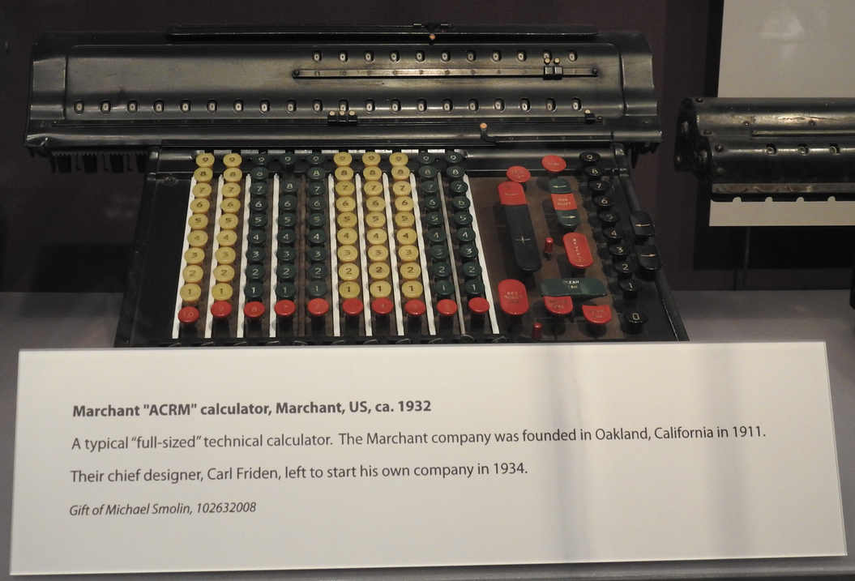
Marchant mechanical calculator
It takes seconds to enter the addend and augend, and ~1 second to add via
turning of gears. From the Computer History Museum, Mountain View, CA
Imaged on July 08, 2017 © George Adams
Notes:
COST TO ACQUIRE???????
A mechanical computer widely used during the 1920s – 1940s.
It takes seconds to enter the augend and addend, and 1 second to add via
turning of gears. Some were hand-cranked, others had an electric motor.
Image © George Adams. Taken at the Computer History Museum on July 08, 2017.

Slide 26
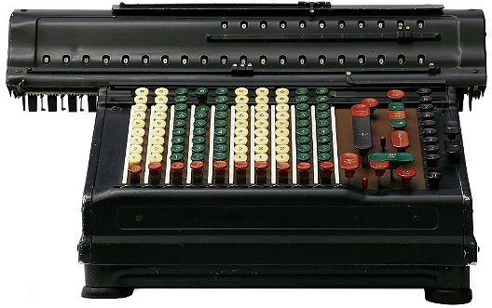
Why are mechanical computers in museums only?
Disadvantages of computation via moving mechanical parts
Volume and mass of parts (big & heavy computer)
Cost to manufacture parts ($$$ computer)
Moving parts wear (degrading functionality)
Moving parts is energy-intensive (hot, $)
Feasible part speeds are subsonic (slow computer)
Need a much better “moving part”

Slide 27
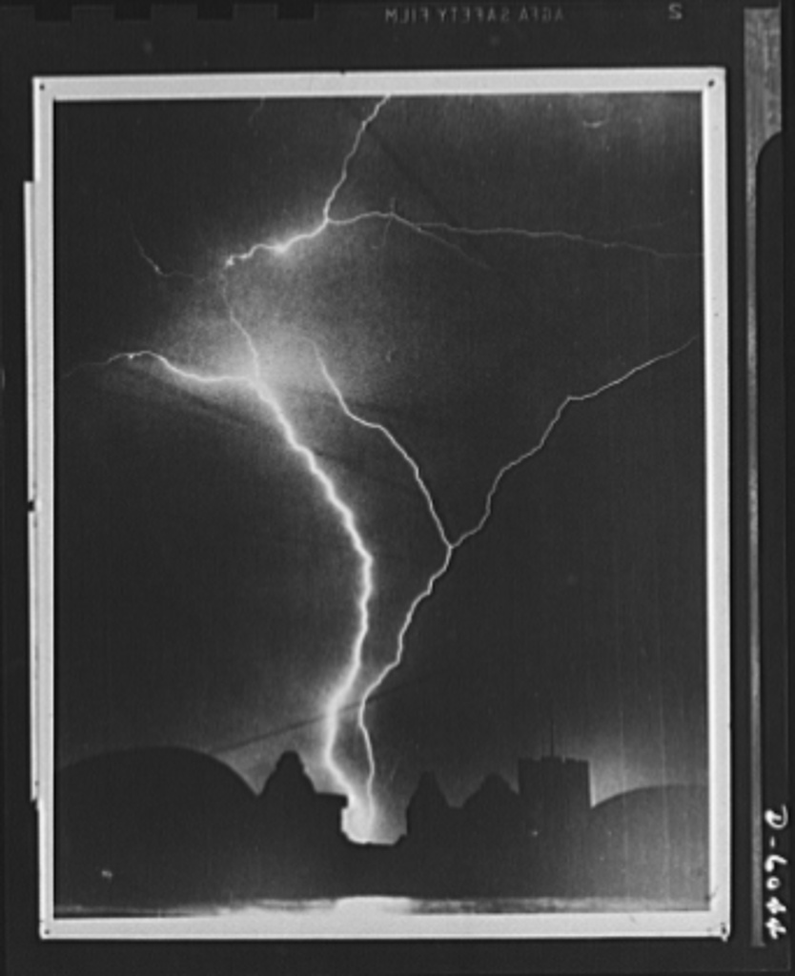
Use electrons as the moving part.
Electron’s charge lets us manipulate them easily with electric fields.
Miniscule volume and mass means a tiny amount of energy sends them through wires and transistors at circa 1/2 the speed of light.
Computers using electrons as the moving part can be small, light, fast, and inexpensive.
Lightning is a burst of electrons in motion
Image courtesy Library of Congress
Notes:
REVISE

Slide 28
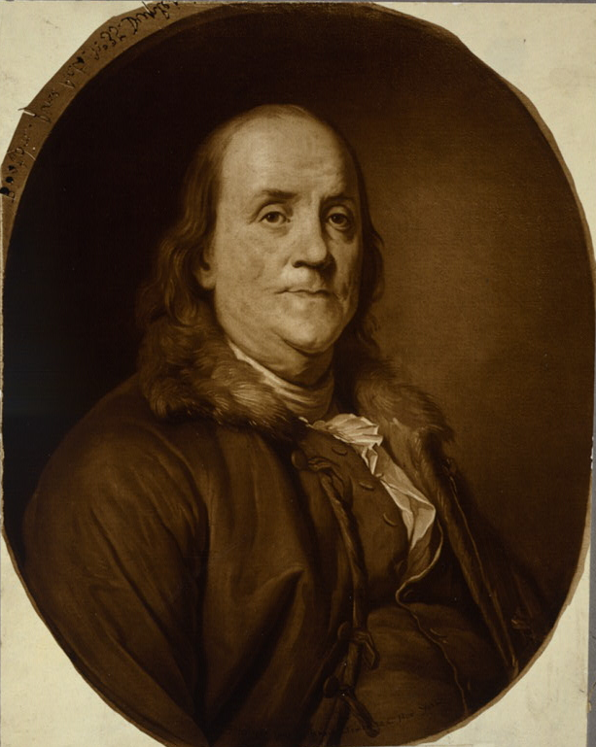
Benjamin Franklin and the electron
When the two electrical charges of the electron and the proton were first recognized, some called the charges Black and Gold.
In 1747
Benjamin Franklin chose the terms we use today: positive and negative
Portrait from Library of Congress

Slide 29
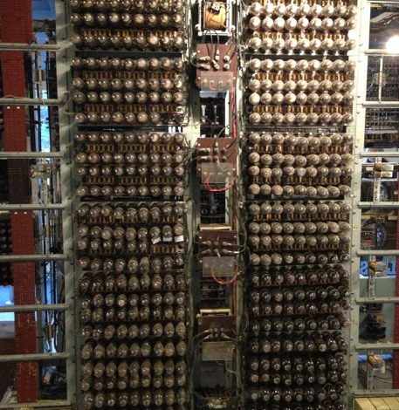
Very early electronic computer
Colossus – built by British cryptographers at Bletchley Park to break the Lorenz cipher
Electronics is the control of electrical energy electrically
Vacuum tubes use electron’s charge to control the flow of electrons in a circuit
2,500 vacuum tubes, the largest electronic circuit of its time
Notes:
Tubes used for Colossus were EF36 pentodes and 7AK7.

Slide 30
Vacuum tube computer pro and con
1000-fold speed increase over mechanical computer with promise of much more 👍 👍
Not much smaller than comparable mechanical 😐
Electrical energy hungry 👎
Poor reliability sharply limits circuit complexity, and thus computational capability (Vacuum tubes burn out like incandescent light bulbs) 👎 👎
Bell Telephone, seeking to replace vacuum tubes, undertakes research in physics of electron behavior in semi-conductive solid crystals

Slide 31
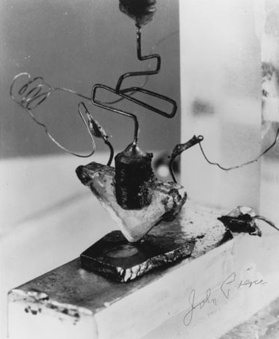
The first transistor, 1947
Built at AT&T Bell Labs
Used a high quality germanium (Ge) crystal made in a Purdue Physics lab in the room now serving as PHYS 201

Slide 32
Transistor #1 made in 1947
Today, humans make ~8x10¹² transistors every second, and that number continues to increase
So, during this lecture, 3,300,000 transistors will be manufactured for you, on a per capita basis
You could say that Homo sapiens is becoming Homo transistorus
Notes:
Circa 1100 transistors per capita per second
Because 60*60*24 = 86,400 seconds/day and 8x10^12/7x10^9 = 1.14x10^3 transistors per person per second.
Your recommended daily allowance of transistors is 86,400 x 1.14x10^3 = 98,500,000 transistors / day

Slide 33
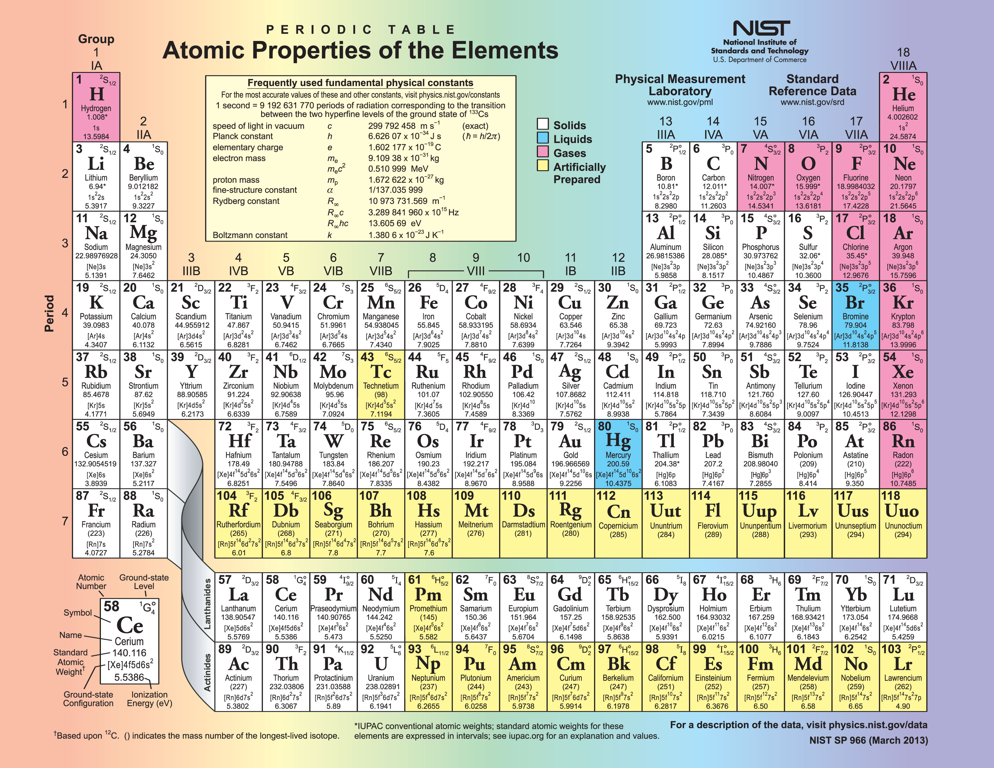
Today’s electronic computing platform is usually built on elemental silicon (Si) crystals. Ge and certain alloys – GaAs, SiN – are also in use. A 2-D form of C, called graphene, may become important soon, as well as a 2-D form of P.

Slide 34
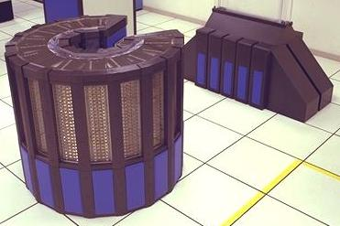
Computers hardware milestones
May 1985 NASA Ames Research Center acquires a Cray-2 “Supercomputer”
Photo courtesy NASA
Notes:
14 columns of logic, memory, and power supplies. 300 degree arc, 45 inches (114 cm) tall, 53 inches (135 cm) in diameter. Fluorocarbon liquid immersion cooling. Water heat exchanger. Floor tiles are 2’ x 2’ or 61cm x 61cm. First computer to contain more transistors than there were humans.

Slide 35
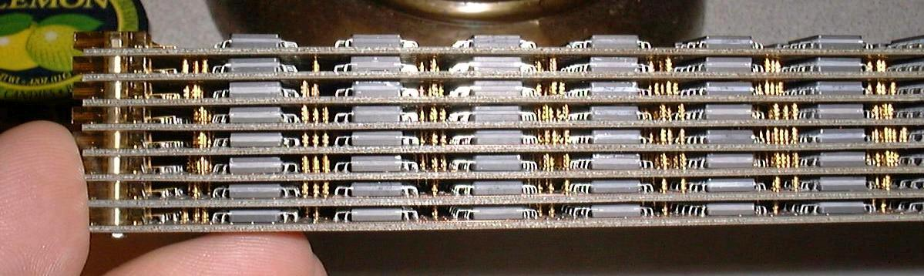
Cray-2 circuit module
Photo by Alan Kilian, former Cray employee, from personal collection of Cray components.
https://en.wikipedia.org/wiki/Cray-2#/media/File:Cray-2_module_side_view.jpg
Cooled by immersion in an chilled fluid:
complex and expensive compared to air cooling
Notes:
It’s nice if your smartphone is water resistant, but think about making your computer “water-tight”!

Slide 36
Computers change – 26 years later
Cray-2 (May 1985)
Fastest computer on the planet
Processors: 4, custom, 244 MHz clock
Main memory: 1.0 GByte
Volume: 1.5 m³ Mass: 2,500 kg
Power: 200 kilowatts (~ $500/day)
Cost: circa USD $15 million

Slide 37
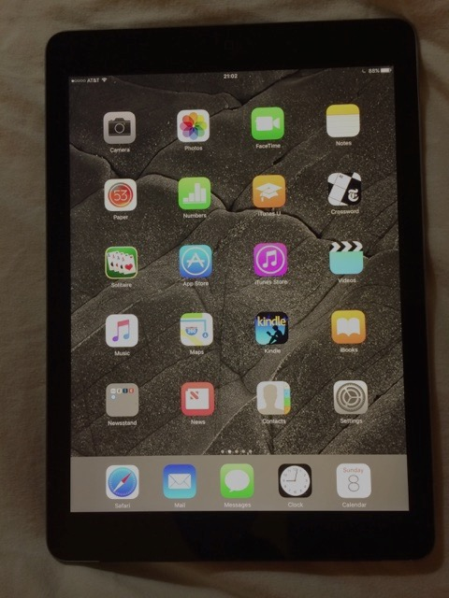
Computing is change – 26 years later
Cray-2 (May 1985)
Fastest computer on the planet
Processors: 4, custom, 244 MHz clock
Main memory: 1.0 GByte
Volume: 1.5 m³ Mass: 2,500 kg
Power: 200 kilowatts (~$500/day)
Cost: circa USD $15 million
Just as fast on a benchmark program
Processor: 2 core ARM Cortex-A9
Main memory: 0.512 GByte
Volume: 4x10⁻⁴ m³ Mass: 0.61 kg
Power: 3 Watts (< $0.01/day)
Cost: USD $499
Apple iPad 2 (March 2011)
Notes:
End of Lecture 01.

Slide 38
What is a computer?
A computer is a technology-dependent machine for automating computation
Computers have been constructed from
Humans
Mechanical parts
Silicon-based transistors
Future technologies may include
Graphene (a form of carbon)-based transistors
Quantum-effect devices
…
“Any sufficiently advanced technology
is indistinguishable from magic.”
Arthur C. Clarke
Science fiction writer; the third of his Three Laws.

Slide 39
How is logic
embodied in hardware?

Slide 40
Today’s lecture preparations
Have paper with pencil ready for use today
Have iClicker ready
Week 01 Assignment recap
Login to Blackboard; register iClicker, join Piazza
Attend your lab session and complete Lab 01
Read textbook Chapters 1 and 2
Read through course syllabus and information on Blackboard
Notes:
UPDATE URL

Slide 41
Lecture 02 – From math to circuits
2018.01.10
Computers are great tools, but they need to be applied to the physical world.
Tony Fadell
iPod, Nest thermostat, Google Glass division

Slide 42
Algebras
There are many different algebras
An algebra is like a mathematical set of gears and linkages, a machine, to process elements of a set
A particular algebra describes the elements of its set and how operation(s) of the algebra manipulate them
Example algebra: “Grade School” algebra
Elements are from the set of Integers or Rational numbers
Manipulations are the binary operations (operations that take two operands) known as +, –, x, and /

Slide 43
Defining an algebraic operation
Operations are defined by tables of results
Example: table defining addition of Natural numbers (positive Integers and zero)
+ | 0
0 | 0
+ | 0 | 1
0 | 0 | 1
1 | 1 | 2
+ | 0 | 1 | 2
0 | 0 | 1 | 2
1 | 1 | 2 | 3
2 | 2 | 3 | 4
+ | 0 | 1 | 2 | 3
0 | 0 | 1 | 2 | 3
1 | 1 | 2 | 3 | 4
2 | 2 | 3 | 4 | 5
3 | 3 | 4 | 5 | 6
+ | 0 | 1 | 2 | 3 | …
0 | 0 | 1 | 2 | 3 | …
1 | 1 | 2 | 3 | 4 | ...
2 | 2 | 3 | 4 | 5 | …
3 | 3 | 4 | 5 | 6 | …
… | … | … | … | … | ...

Slide 44
Can a computer perform Grade School addition?
Live attempt at Grade School addition using the HP-15C calculator
Based on HP-15C, the answer to our question is “No!”
Why?
Answer: A finite amount of hardware cannot represent every element of a set that has infinite cardinality
Important Fact: Computers are comprised of a finite amount of hardware.
Because, perhaps most fundamentally, the Universe is estimated to contain fewer than 10⁸⁰ protons and electrons
¯\_(ツ)_/¯ We are going to have to work around hardware limitations

Slide 45
Which algebra should we choose?
Computers today, generally, are binary devices, 2-symbol computational machines
We need an algebra that is
on a set with two elements, and with
operations that can
be readily implemented by electronic circuits, and
that can be composed in ways that allow
us to write useful and efficient programs

Slide 46
Boolean algebra, an algebra to describe computers
George Boole, mathematician develops a 2-symbol, three operation algebra in 1847
A Boolean algebra is a set {0,1} on which are defined two binary operations + and ⦁ and one unary operation ’ such that the following properties hold for all x, y, z ∈ {0,1}
Commutative property for + and ⦁ x+y = y+x and x⦁y = y⦁x
Associative property for + and ⦁ x+(y+z) = (x+y)+z and x⦁(y⦁z) = (x⦁y)⦁z
Distributive properties for ⦁ over + and + over ⦁ x⦁(y+z) = (x⦁y)+(x⦁z) and x+(y⦁z) = (x+y)⦁(x+z)
Identity properties x+0 = x and x⦁1 = x
Complementation x+x’ = 1 and x⦁x’ = 0

Slide 47
Boolean algebra, an algebra to describe computers
George Boole, mathematician develops a 2-symbol, three operation algebra in 1847
A Boolean algebra is a set {0,1} on which are defined two binary operations + and ⦁ and one unary operation ’ such that the following properties hold for all x, y, z ∈ {0,1}
Commutative property for + and ⦁ x+y = y+x and x⦁y = y⦁x
Associative property for + and ⦁ x+(y+z) = (x+y)+z and x⦁(y⦁z) = (x⦁y)⦁z
Distributive properties for ⦁ over + and + over ⦁ x⦁(y+z) = (x⦁y)+(x⦁z) and x+(y⦁z) = (x+y)⦁(x+z)
Identity properties x+0 = x and x⦁1 = x
Complementation x+x’ = 1 and x⦁x’ = 0
Blue = differences vis-à-vis grade school algebra on real numbers.

Slide 48
Statements and Boolean Logic
Denote statement truth values using 2 symbols, typically {T,F} or {0,1}
Example statements
Statement A: “10 < 7”
Statement B: “Today is Friday”
Notes:
This slide works for a lecture given on Friday; adjust as needed

Slide 49
Unary operation NOT (negation)
NOT function inverts the truth value of a statement (called negation in mathematics)
NOT A is written A’ or ¬A or A
Definition of NOT A in the form of a truth table, one using F and T, one using 0 and 1
_
A | A’
F | T
T | F
A | A’
0 | 1
1 | 0

Slide 50
Boolean algebra assumes “perfection”
Boolean algebra has exactly 2 symbols: discrete
Computations of interest have many steps, each with Boolean algebraic actions to perform
Each Boolean step produces a result represented exactly in {0,1} and can pass result to next step as a perfect input
A perfect system, like a perfect vacuum, exists only in the mind
What happens when we try to build a physical machine to implement Boolean algebra?

Slide 51
Being discrete in the real world
Circuit reality check
Due to manufacturing variability, exactly identical electrical components are not feasible
Thus, circuit voltage not one of two perfect values
For multi-step computations we likely want to use the same logic circuit for multiple steps to reduce the cost of hardware
Thus, circuit input and output (result) voltages will represent both elements of {0,1} over time as successive data is processed
A real circuit cannot instantaneously change between two distinct voltages, so other voltages will be present

Slide 52
Digital: approximating perfection
Circuit can produce two distinct output voltages, using power supply and ground as two references (say, +5 V and 0 V)
Circuit can be built to process any input voltage falling within a reasonable range of +5 and 0 as if it were the ideal value
Circuit can change output voltage quickly, so intermediate voltage values appear only briefly
Circuit behaving as above is called digital

Slide 53
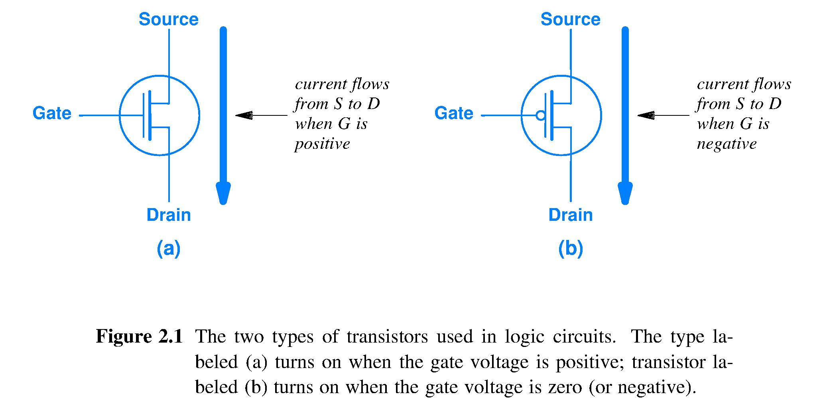
Electrically controlled On/Off switch
Metal-Oxide-Semiconductor Field Effect Transistors (MOSFETs) can act as an ON/OFF switch
Gate voltage turns the path between the Source and Drain ON (low resistance) or OFF (high resistance)
Symbol for MOSFET that Added “dot” means turns ON with high Gate MOSFET turns OFF voltage

Slide 54
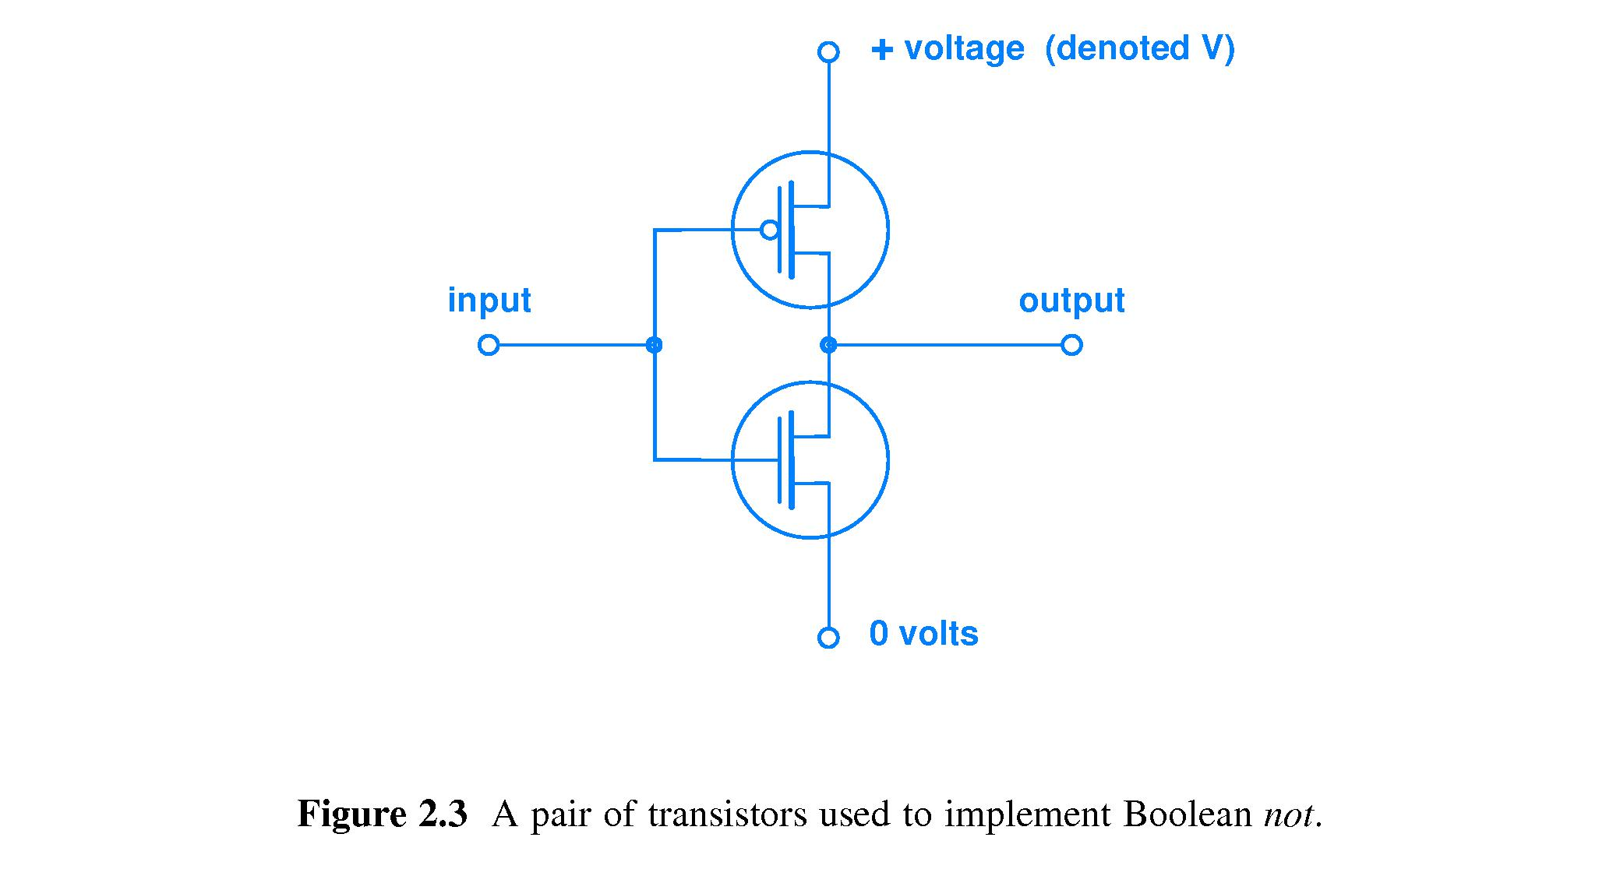
Operation of digital NOT circuit
Input voltage controls ON/OFF operation of transistor, but DOES NOT travel through the transistor.
Output voltage comes from one of the two reference voltages through one transistor to the output node.
V
}
V
ON
Output voltages are at the high-quality edges of the allowed voltage ranges.
Acceptable input ranges shown by yellow bands.
OFF
Voltage
Voltage
OFF
ON
}
0
0
Digital circuit both computes and resets voltage quality

Slide 55
Circuit to perform Boolean NOT
Let low voltage at a circuit node mean Boolean 0 and let high voltage mean Boolean 1
ON
OFF
input = low voltage
output = high voltage
input = high voltage
output = low voltage
ON
OFF
input | output = ¬input
0 | 1
1 | 0

Slide 56
Complementary MOSFETs (CMOS)
A secret behind the success of Moore’s Law is a rule:
“Turn off the lights when they are not needed.”
Complementary MOSFETs made this easy.
Same gate voltage all the time means only for an instant, when the input changes value, will both MOSFETS be between ON and OFF, that is, both somewhat ON.
Circuit energy use (flow from +V input to 0 volts) occurs mostly during brief transition. Thus, CMOS is a very low energy circuit.
CMOS is thus very low power even when switched OFTEN.
Notes:
How many have heard the term CMOS?
We see a more abstract circuit schematic here, to keep the focus right were we need it.
“Switched” is what a circuit does when we put it to WORK.

Slide 57
AND operation defining truth table
AND (called conjunction by mathematicians)
A AND B is written A∧B or AB
Truth tables using {T,F}, {0,1}
A | B | A B
F | F | F
F | T | F
T | F | F
T | T | T
A | B | A B
0 | 0 | 0
0 | 1 | 0
1 | 0 | 0
1 | 1 | 1
Notes:
This slide works for a lecture given on Friday; adjust as needed

Slide 58
OR operation
OR (called disjunction)
A OR B is written A∨B or A+B
A | B | A + B
F | F | F
F | T | T
T | F | T
T | T | T
A | B | A + B
0 | 0 | 0
0 | 1 | 1
1 | 0 | 1
1 | 1 | 1

Slide 59
Live Example
Construct and discuss several truth tables
Use your paper and writing implement

Slide 60
How many 2-input operations exist?
Define an arbitrary 2-input operation with symbol ☉ by filling in its truth table:
Defining ☉ requires 4 independent choices from a set of 2 symbols, there are 2⁴ ways ∴ 2⁴ = 16 2-input operations
A | B | A ☉ B is defined by choices made
0 | 0 | Chose one from {0,1} to define 0☉0
0 | 1 | Chose one from {0,1} to define 0☉1
1 | 0 | Chose one from {0,1} to define 1☉0
1 | 1 | Chose one from {0,1} to define 1☉1

Slide 61
Key knowledge
Truth tables of these seven operations: NOT, AND, OR, XOR, NAND, NOR, XNOR
Become able to
memorize NOT, AND, OR, XOR, infer the rest
mentally envisage these truth tables and extract a truth value using only your mind
compare and contrast the tables of different operations

Slide 62
How does a
NAND gate
work?

Slide 63
Today’s lecture preparations
Week 01 Assignment recap
Login to Blackboard; register iClicker, join Piazza
Attend your lab session and complete Lab 01
Read textbook Chapters 1 and 2
Read through course syllabus and information on Blackboard
Read Lab 02 posted on Blackboard in preparation for next week
Homework 01 posted; due Thursday Jan. 18
Notes:
UPDATE URL

Slide 64
Lecture 03 – Logic circuits
2018.01.12 Dr. McCoy: Mr. Spock, remind me to tell you that I'm sick and tired of your logic.
Spock: That is a most illogical attitude.

Slide 65
NAND operation, (AB)’
A | B | A NAND B
0 | 0 | 1
0 | 1 | 1
1 | 0 | 1
1 | 1 | 0
NAND is the negation of the Boolean AND operation
Any Boolean function can be implemented solely in terms of NAND operations

Slide 66
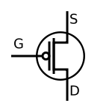
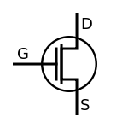
Key invention – CMOS circuit for (AB)’
Parallel paths from +V to Out. If either or both transistors is On, if either or both input A or B is low, Out = +V
+V voltage
A
B
Out
A
Series path from 0 volts to Out. Both transistors must be On, both inputs A and B must be high, to make Out = 0 volts
B
0 volts

Slide 67
Logical NOR operation, (A+B)’
Truth tables are a kind of software
They define an operation, or function
They are abstract: A, B stand for any pair of statement truth values
Given an A and a B, the table says what the output must be (although it does not say how to produce it)
A | B | A NOR B
0 | 0 | 1
0 | 1 | 0
1 | 0 | 0
1 | 1 | 0
Notes:
Just what are we looking at here?

Slide 68
Live example
Design circuit to compute NOR operation

Slide 69
Summary
How is logic embodied in hardware?
We build digital circuits from Complementary MOSFET transistors, called CMOS for short
Boolean algebra describes operations on set with two elements, basis for describing the logic we use in electronic computers
NAND gate circuit is the key invention for building large, useful computational circuits
+V voltage
A
B
Out
A
B
0 volts

Slide 70
Assignment for Week 02
Helpful conversations taking place on Piazza
Lab 02 this week
HW 01 now due Thursday, Aug. 31
Finish textbook chapters 1 and 2, read chapters 4 and 5 next (will come back to chapter 3 later)
Notes:
15 clickers recorded, but without associated student name

Slide 71
Voltage and current, part 1
Kirchhoff’s electrical circuit behavior laws
Voltage Law: the sum of voltages, V, across the devices around a closed circuit is zero
Current Law: the sum of currents, I, entering and leaving a node (vertex in the graph of the circuit) in a circuit is zero
Electrons neither accumulate nor deplete at a node
Details of sign convention for voltage and current
Electrons gaining energy flow from – to + by convention, electrons loosing energy flow from + to –
Current flow into a node in a circuit is given a positive sign, flow leaving a node is negative

Slide 72
Voltage and current, part 2
Ohm’s Law: the voltage measured between two points in a circuit is proportional to the product of the current flowing between those two points and the total resistance between those two points V = I x R units are volts = amperes x ohms

Slide 73
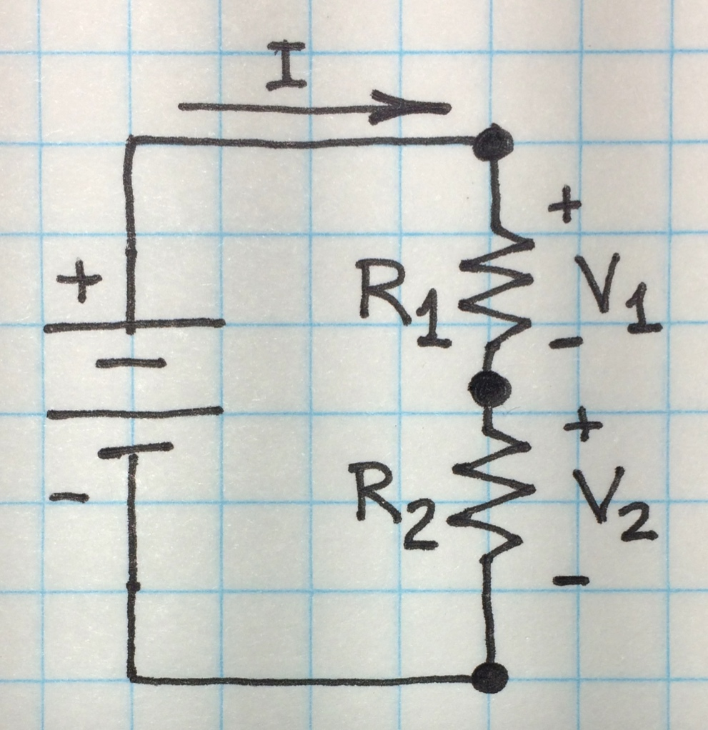
Example circuit
Circuit with battery driving two resistors in series
V volts of energy gain from battery; V₁ and V₂ volts of energy loss from resistors, respectively
Resistors of values R₁ and R₂ ohms (
Current I flows around the circuit
V

Slide 74
Example circuit with supply voltage V
By Kirchhoff’s Voltage Law V + V₁+ V₂ = 0 or V = V₁+ V₂
By Kirchhoff’s Current Law, I, must flow through resistors R₁ and R₂ equally
Ohm’s Law says voltage from Output to Ground I = V₂/R₂ and voltage from High to Ground I = V/(R₁+ R₂)
thus Output voltage V₂ is V₂= V(R₂/(R₁+ R₂))
High
V
Output
Ground

Slide 75
Creating two voltage levels
Key idea is a two-resistor “voltage divider”
Because V(R₂/(R₁+ R₂)) = V₂
Obtain two near-ideal V₂ levels of +V and Ground via two extreme cases:
Build R₂ << R₁ V(R₂/(R₁+ R₂) ≐ Vx0 = 0 = V₂
Build R₂ >> R₁ V(R₂/(R₁+ R₂) ≐ Vx1 = V = V₂
Output is a circuit node with desired two digital voltage levels
High
V
Output
Ground
75
Notes:
Just two resistors and, presto, digital logic.
It’s called hardware, but really it’s easyware!

Slide 76
A switch is a two-valued resistor
Open (not connected) switch presents very high resistance to the flow of electricity
Closed (connected) switch presents a very low resistance to the flow of electricity
Switch implementation examples
Wall switch: mechanical “signal” controls switch on/off condition
MOSFET: electrical signal controls on/off

Slide 77
Series and parallel resistors
Total resistance of resistors in series is the sum of the resistances: R_{Total} = R₁+R₂+ … +R_{n}
Low R_{Total} requires all resistors have low value
Total resistance of resistors in parallel is 1/R_{Total} = 1/R₁ + 1/R₂ + … + 1/R_{n}
Any one resistor low is sufficient for low R_{Total}
…
R₁
R₂
R_{n}
R₁
R₂
…
R_{n}

Slide 78
NAND circuit is a voltage divider
+V voltage
High
Parallel
resistors
A
B
V
Out
Output
A
Series
resistors
B
Ground
78
78
0 volts

Slide 79
Digital Logic
Built on a system of two values; those values can be interpreted as
Positive voltage and zero volts (ground)
High and low
True and false
Asserted and not asserted
Underneath it’s all analog and in our case wires, devices, and electrons

Slide 80


Abstraction
Digital logic behavior, a joy to behold,
but paddling like hell underneath
to make it happen.

Slide 81
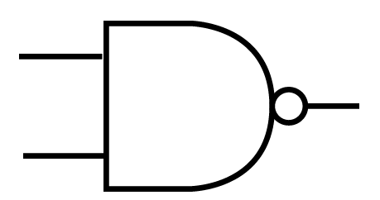
Diagram levels of abstraction
Gate symbol – shows no circuit design information
+V voltage
A
B
Out
A
B
0 volts
More abstract representation →

Slide 82
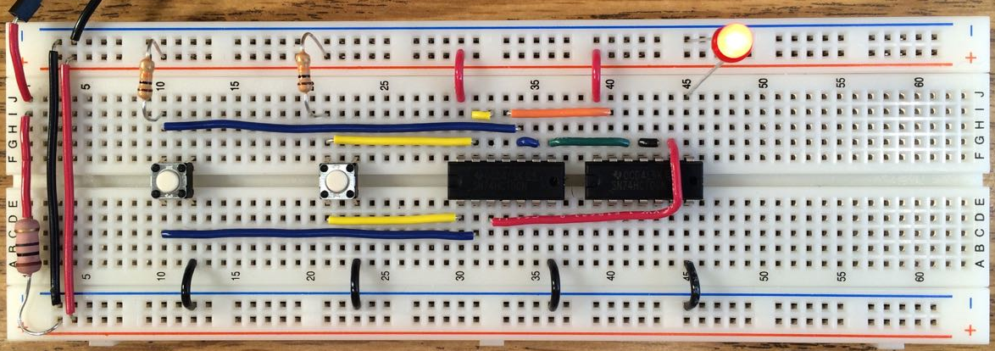
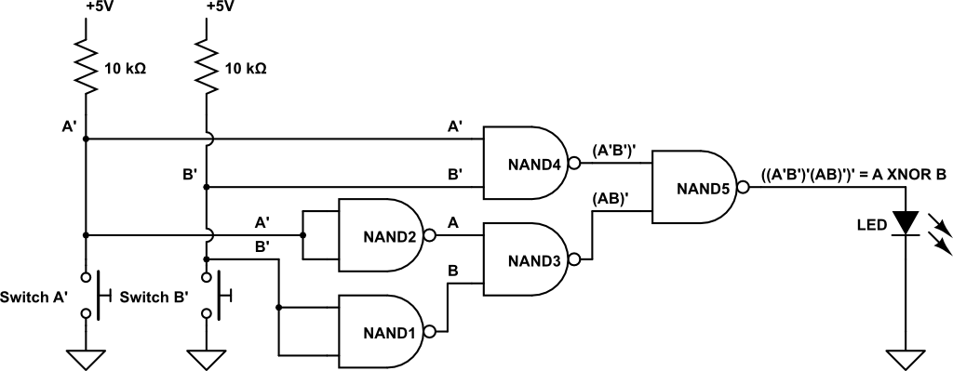
Levels of abstraction – another example
More abstract representation →

Slide 83
Comparison of HW gates and SW code
How do hardware (HW) and software (SW) behave?
What is required to prepare each for computation?
SW: declarations; translate from source to machine code
HW: turn on the power supply
When is input accepted and what input is acceptable?
SW accepts input when commanded and as specified, e.g., double b[SIZE]; fp = fopen("test.bin","rb"); size_t ret_code = fread(b, sizeof *b, SIZE, fp) // reads array of doubles
HW continuously accepts inputs
HW accepts only two voltage values

Slide 84
Comparison of HW gates and SW
Functionality
of SW: Decided at any time; basically limitless; some programs have long running times
of HW gate: Fixed in advance; limited to a few choices; execution time measured in intervals of 10⁻¹⁰ seconds
Output
from SW: various forms , formatted, any symbols
from HW gate: a wire, carrying one of two voltages, denoting a bit

Slide 85
Summary
Voltage divider style circuit is the basis for two-level digital logic circuits
Powered HW is always active; whereas, even when SW is loaded into memory it may be suspended rather than executing

Slide 86
Summary
Automating computing means using a machine
Using machines to compute depends on finite symbol sets
In an analog world, error accumulates
We can make machines that behave digitally
Finite symbol sets match manufacturing capability
Easy symbol distinguishability reduces errors
Key concepts to achieve the above
Binary (and higher-radix) number systems
Voltage band for each symbol and voltage gaps between each pair of symbols for error resistance

